Slide 1
RPA
Robotic Process Automation using UiPath

Slide 2
Day 1 - Topics Covered
What is RPA
What should be automated
Techniques of automation
Benefits of RPA
Components of RPA
RPA vendors
Components of UiPath
UiPath Studio
UiPath Orchestrator
UiPath Robot
Types of workflows
Sequence + Activity 1
Flowchart + Activity 2
State Machines + Activity 3
Global Exception Handlers

Slide 3
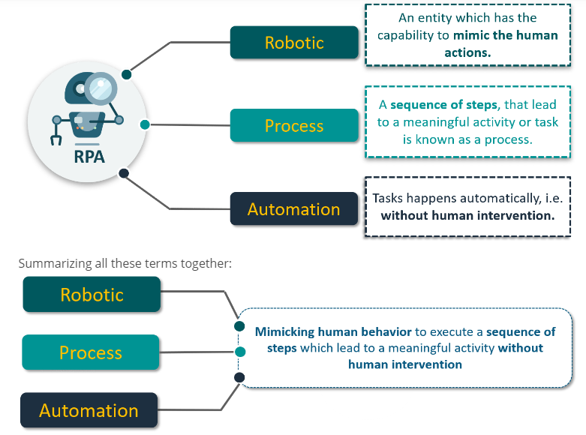
What is Robotic Process Automation?

Slide 4
What should be automated?
Well defined and rule-based steps
Logical
An input to the task can be diverted to the software system
Input can be deciphered by software systems with available techniques
The output system is accessible
Benefits are more than the cost

Slide 5
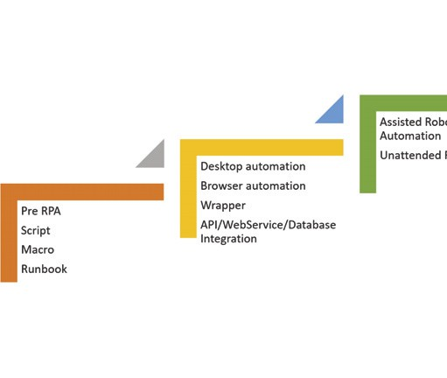
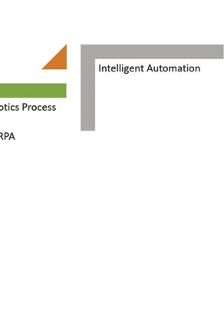
Techniques of automation

Slide 6
Benefits of RPA across industries
Business process outsourcing (BPO): With RPA and its benefits of reduced costs, the BPO sector can now depend less on outsourced labor.
Insurance: From managing policies, to filing and processing claims across multiple platforms, provides an ideal environment for the use of RPA technology.
Financial sector: From day-to-day activities and handling an enormous amount of data, to performing complex workflows
Utility companies: These companies (such as gas, electricity, and water) deal with a lot of monetary transactions and can leverage RPA to automate tasks such as meter reading, billing, and processing customer payments.
Healthcare: Data entry, patient scheduling, and more importantly billing and claims processing, are important areas where RPA can be used.

Slide 7
Benefits of RPA
Higher quality services, greater accuracy
Improved analytics
Reduced costs
Increased speed
Greater compliance
Agility
Comprehensive insights
Versatility
Simplicity
Scalability
Time Saving
Better Management

Slide 8
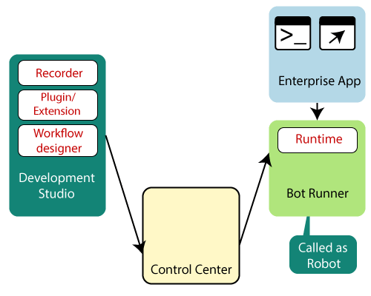
Components of RPA
Notes:
1. Recorder
The recorder is the part of the development studio that developers use to configure the Robots. It is like the macro recorder in Excel, the bot recorder in any platform, records steps. It records mouse and keyboard movements on the UI and this recording can be replayed to do the same steps again and again. This enables rapid automation.
2. Development studio
The development studio is used by developers to create Robot configuration or train the Robots. Using the development studio, a set of instructions and decision-making logic is coded for Robots to execute.
3. Extensions and plugins
Most platforms offer many plugins and extensions to ease the development and running of bots. In many applications, such as Java SAP, it is not easy to individually identify controls of the UI through traditional techniques. RPA vendors have developed plugins and extensions to help with these issues.
4. Bot runner
This is also referred to as the Robot, other components make it run.
5. Control center
The objective of the control room is to provide Robot management capabilities. It monitors and controls a Robot's operation in a network. It can be used to start/stop Robots, make schedules for them, maintain and publish code, redeploy Robots to different tasks, and manage licenses and credentials.

Slide 9
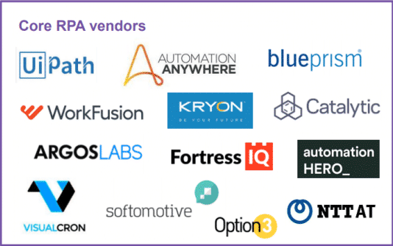
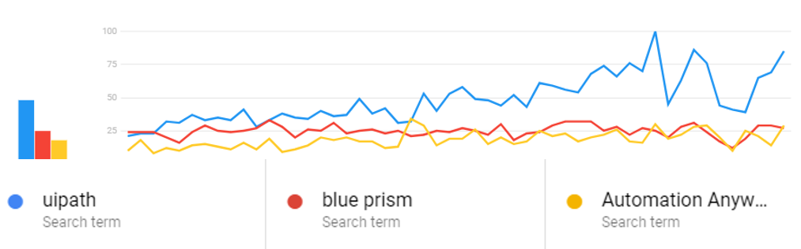
RPA Vendors

Slide 10
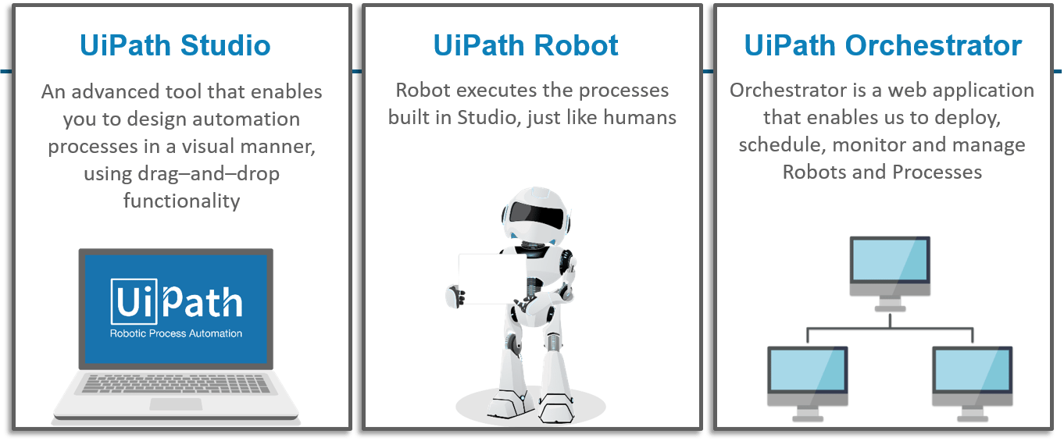
Components of UiPath

Slide 11
UiPath Studio
UiPath Studio encapsulates both simple and complex solutions for application integration and automating third-party applications, administrative IT tasks, and business IT processes.
Studio is at the heart of automation with UiPath products.
Activities form into comprehensive workflows in Studio, which are then executed by the Robot and published to Orchestrator.
Studio comes with two types of available profiles for developers and business users:
Studio offers a plethora of tools for designing complex and large workflows
StudioX Preview is addressed to business users for automating tasks with the use of integration with Microsoft Excel application.

Slide 12
UiPath Robot
The Robot is UiPath’s execution agent that enables you to run processes developed in Studio. Robots need to be connected to Orchestrator in order to execute processes or they have to be licensed locally.
The Robot is split into four components as follows:
Service
SCM-managed Service
User Mode Service
Executor
Tray
Command Line Interface
The Robot can open interactive Windows sessions, under the Local System account, and has all the rights of a Windows service.

Slide 13
UiPath Orchestrator
UiPath Orchestrator is a server-based application that lets you orchestrate your Robots, hence the name Orchestrator.
It runs on a server or cloud and connects to all the Robots within the network, whether Attended, Unattended, or Free.
It has a browser-based interface that enables the orchestration and management of hundreds of Robots with a click.
Orchestrator lets you manage the creation, monitoring, and deployment of resources in your environment, acting in the same way as an integration point with third-party applications.
Orchestrator Server uses:
IIS Server
SQL Server
Elasticsearch
Kibana

Slide 14
Types of Workflows
Sequences
Flowcharts
State Machines
Global Exception Handler

Slide 15
Sequences
Sequences are the smallest type of project. They are suitable to linear processes as they enable you to go from one activity to another seamlessly, and act as a single block activity.
One of the key features of sequences is that they can be reused time and again, as a standalone automation or as part of a state machine or flowchart.
ACTIVITY 1 :
Create a sequence that asks the user for his first and last name, and designation, and then displays the answers.

Slide 16
Activity 1 – Step-by-Step Solution
Create a blank process and, on the Design tab, in the File group, select New > Sequence. The New Sequence window is displayed.
In the Name field type a name for the automation, such as "First Sequence", and leave the default project location or add a subfolder. Click Create. The Designer panel is updated accordingly.
Create three String variables such as FirstName, LastName, Designation so that you can store data from the user in them. Leave the Default field empty, to indicate that there is no default value.
Drag three Input Dialog activities to the Designer panel, one under the other.
Select the first Input Dialog and, in the Properties panel, add a Label asking for the first name of the user, and a custom Title.
In the Result field add the FirstName variable. This indicates that this variable is going to be updated with the value added by the user at this point.
Repeat steps 6 - 7 for the second and third Input Dialog activities to ask the user for his last name and hair color, and store them in the LastName and Designation variables
Add a Message Box activity under the third Input Dialog.
Select the Message Box and, in the Properties panel, in the Text field, add the variables and a string to enable you to display all information gathered from the user, such as:
FirstName + “ ” + LastName + “ “ + “is designated as ” + Designation + “.”

Slide 17
Flowcharts
Flowcharts can be used in a variety of settings, from large jobs to small projects that you can reuse in other projects.
The most important aspect of flowcharts is that, unlike sequences, they present multiple branching logical operators, that enable you to create complex business processes and connect activities in multiple ways.
Flowcharts come with the Auto Arrange option in the context menu.
ACTIVITY 2 :
Build a guessing game that generates a random number from 1 to 999 that the user must guess

Slide 18
State Machines
A state machine is a type of automation that uses a finite number of states in its execution. It can go into a state when it is triggered by an activity, and it exits that state when another activity is triggered.
They also enable you to add conditions based on which to jump from one state to another. These are represented by arrows or branches between states.
There are two activities that are specific to state machines, namely State and Final State, found under Workflow > State Machine.
You can only create one initial state, yet it is possible to have more than one Final State.
The State activity contains three sections, Entry, Exit and Transition(s), while the Final State only contains one section, Entry. Both of these activities can be expanded by double-clicking them, to view more information and edit them.
The Entry and Exit sections enable you to add entry and exit triggers for the selected state, while the Transition(s) section displays all the transitions linked to the selected state.
ACTIVITY 3 : Try the same guessing number game using state machines

Slide 19
Global Exception Handler
The Global Exception Handler is a type of workflow designed to determine the project’s behavior when encountering an execution error. Only one Global Exception Handler can be set per automation project.
By default, the template retries the exception 3 times before aborting the execution. This default behavior can be changed from inside the template.
Note:
The Global Exception Handler is not available for library projects, only processes.
The Global Exception Handler has two arguments, that should not be removed.
The first argument is ErrorInfo with the In direction and it stores information about the error that was thrown and the workflow that failed. The level of the error to be logged can be set in the Log Message activity.
The second argument, Result has the Out direction and it is used for determining the next behavior of the process when it encounters an error. The following values can be assigned to this argument:
Continue - The exception is re-thrown.
Ignore - The exception is ignored, and the execution continues from the next activity.
Retry - The activity which threw the exception is retried. Use the RetryCount method for errorInfo to count the number of times the activity is retried.
Abort - The execution stops and throws the exception after running the current Global Exception Handler.

Slide 20
Day 2 - Topics Covered
UiPath Studio - The user interface
The Ribbon
Quick Access Toolbar
Designer panel
Properties panel
Outline panel
Arguments panel
Variable panel
Import panel
Activity panel
Library panel
Project panel
Output panel
Task Recorder
Basic Recorder
Desktop Recorder
Web Recorder
Citrix Recorder

Slide 21
UiPath Studio - The user interface
The Ribbon
Quick Access Toolbar
Designer panel
Properties panel
Outline panel
Arguments panel
Variable panel
Import panel
Activity panel
Library panel
Project panel
Output panel

Slide 22
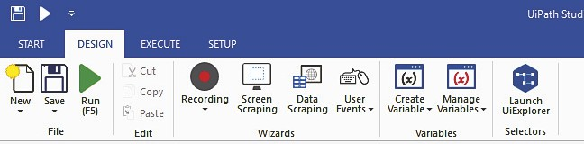
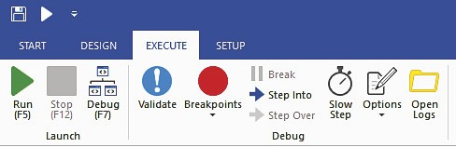
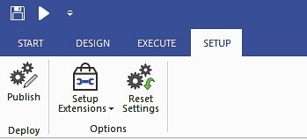
The Ribbon
This panel located at the top of the user interface and consists of four tabs:
1. START: This is used to start new projects or to open projects previously made.
2. DESIGN: This is to create new sequences, Flowcharts, or state machines, or to manage variables.
3. EXECUTE: This is used to run projects or to stop them, and also to debug projects.
4. SETUP: This panel is for deployment and configuration options; it has three tools available:
Publish: This is used to publish a project or create a shortcut for it and schedule tasks
Setup Extensions: This is used to install extensions for Chrome, Firefox, Java, and Silverlight
Reset Settings: This is used to reset all settings to defaults

Slide 23
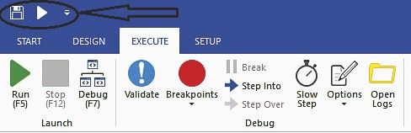
The Quick Access Toolbar
This panel gives the user a shortcut to the most used commands. One can also add new commands to this panel. This is located above the Ribbon on the user interface. The Quick Access Toolbar has been circled in the following screenshot and is indicated by the arrow.
It can be moved above or below the Ribbon. By default, there are two buttons available, Save and Run, which are also available in the DESIGN tab of the Ribbon.

Slide 24
Designer panel
This is the panel where one defines the steps and activities of the projects. It is where a developer does most of the things to record activities or manually drop activities on the canvas. In UiPath, this is equivalent to the code windows of Microsoft Visual Studio. When we develop a Robot, this is the window where we will be organizing various activities in a flow or chain to accomplish a task.
The project a user makes is clearly displayed on the Designer panel and the user has the option of making any changes to it.

Slide 25
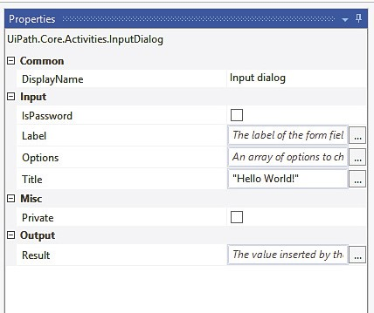
Properties panel
The panel located on the right-hand side of the user interface is for viewing the properties of the activities and for making any changes, if required. You need to select an activity first and then go to the Properties panel to view or change any of its properties.

Slide 26
Activities panel
Located on the left-hand side of the user interface, this panel contains all the activities that can be used in building the project. The activities can easily be used in making a project by simply dragging and dropping the required activity into the required location in the Designer panel.

Slide 27
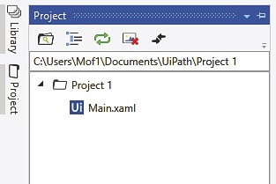
Project panel
With the Project panel, you can view the details of your current project and open it in a Windows Explorer window. It is located on the extreme left-hand side of the design panel, below the Library panel.

Slide 28
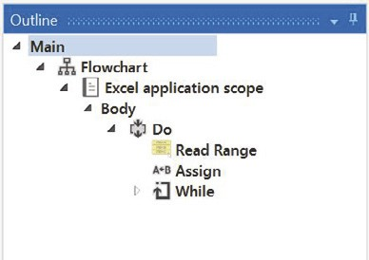
Outline panel
As the name suggests, this panel gives a basic outline of the project. The activities that make up the workflow are visible in this panel. Using this, you may see a high-level outline of the project and you can drill down to see deeper. This panel is especially helpful of large automation projects, where one may otherwise have a tough time going through it.

Slide 29
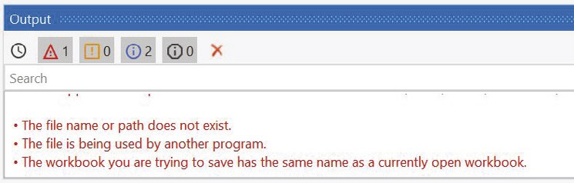
Output panel
This panel displays the output of the log message or write line activities. It also displays the output during the debugging process. This panel also shows errors, warnings, information, and traces of the executed project. It is very helpful during debugging. The desired level of detail can be changed in Execute | Options | Log activities

Slide 30
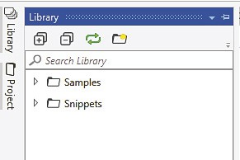
Library panel
With this panel, you can reuse automation snippets. It is located on the extreme left-hand side of the Designer panel

Slide 31
Variable panel
This allows the user to create variables and make changes to them. This is located below the Designer panel.
In UiPath Studio, variables are used to store multiple types of data ranging from words, numbers, arrays, dates, times, and timetables. As the name suggests, the value of the variable can be changed.

Slide 32
Arguments Panel
While variables pass data from one activity to another in a project, arguments are used for passing data from one project to another. Like variables, they can be of various types like String, Integer, Boolean, Array, Generic, and so on.
Since arguments are used to transfer data between different workflows, they also have an added property of direction. There are four types of direction:
In
Out
In/Out
Property
These depend on whether we are giving or receiving data to or from another workflow.

Slide 33
Task recorder
The task recorder is the main reason for RPA's success. With the task recorder, we can create a basic framework for automation. The user's actions on the screen are recorded by the recorder and turned into a recording sequence in the current project. That's how Robots are able to mimic human actions.
There are four types of recording in UiPath Studio:
Basic
Desktop
Web
Citrix

Slide 34
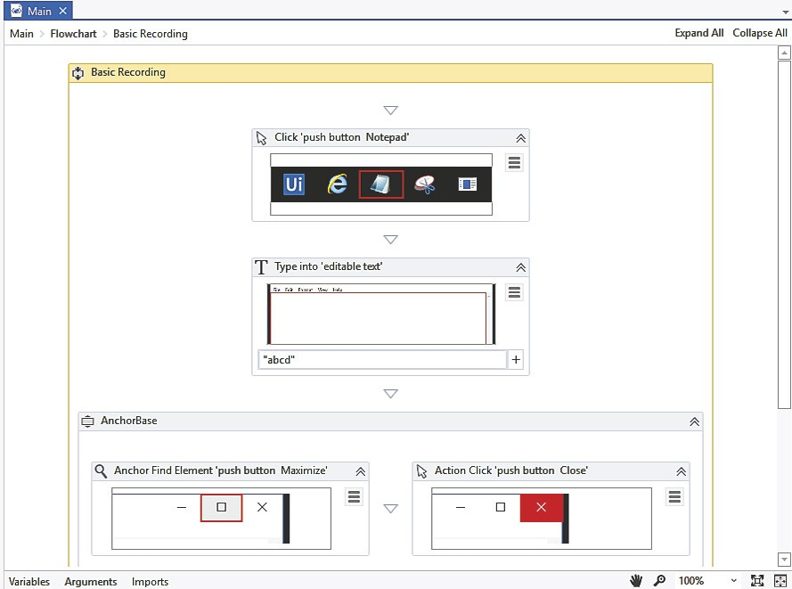
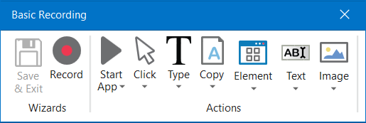
Basic recorder
Basic recorder is used to record activities on the desktop. This type of recorder is used for single activities and simple workflows. The actions here are self-contained and not contained in separate windows

Slide 35
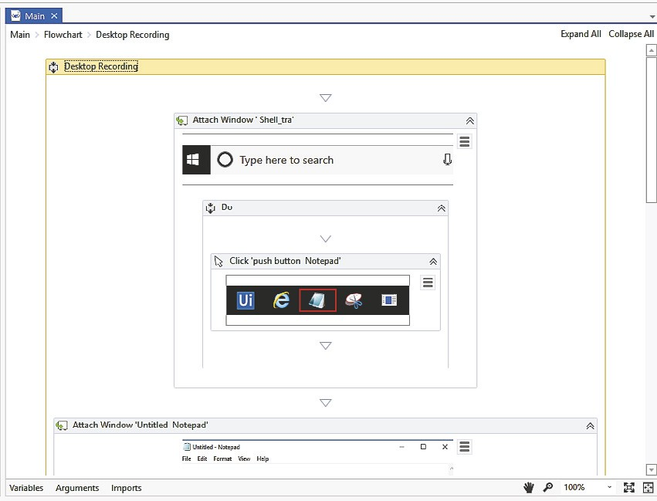
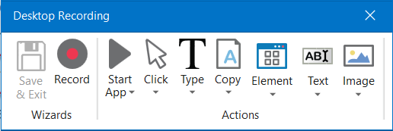
Desktop recorder
Used to record activities on the desktop. However, it is used to record and automate multiple actions and complex workflows.
Each activity here is contained in an Attach Window component, as shown in the following screenshot.
The Attach Window component is especially important to ensure that other windows of the same application do not interfere in the workflow.
UiPath uses the name of the app, the title of the window, and the currently opened file to locate and identify the correct window.

Slide 36
Web & Citrix Recorder
Web recorder: The web recorder, as the name suggests, is used to record actions on web applications and browsers.
Citrix recorder: Citrix is used to record virtual machines, VNC, and Citrix environments. This recording allows only keyboard, text, and image automation.
Some actions are recordable while others are not:
Recordable actions: Left-click on buttons, check boxes, drop-down lists, and other GUI elements. Text typing is also recordable.
Actions that cannot be recorded: Keyboard shortcuts, mouse hover, right-click. Modifier keys such as Ctrl and Alt cannot be recorded.

Slide 37
DEMO ON DESKTOP & BASIC RECORDERS
DEMO: Day2_Demo1_DesktopRecordingWithExcel

Slide 38
Day 3 - Topics Covered
Automation Lifecycle
Variables
Managing Variables
Creating Variables
From the Body of an Activity
From the Properties Panel
From the Variables Panel
Removing Variables
Types of Variables
Text Variables
Activity 1
True or False Variables
Activity 2
Number Variables
Activity 3
Array Variables
Activity 4
Date and Time Variables
Activity 5
Data Table Variables
Activity 6
UiPath Proprietary Variables
GenericValue Variables
QueueItem Variables

Slide 39
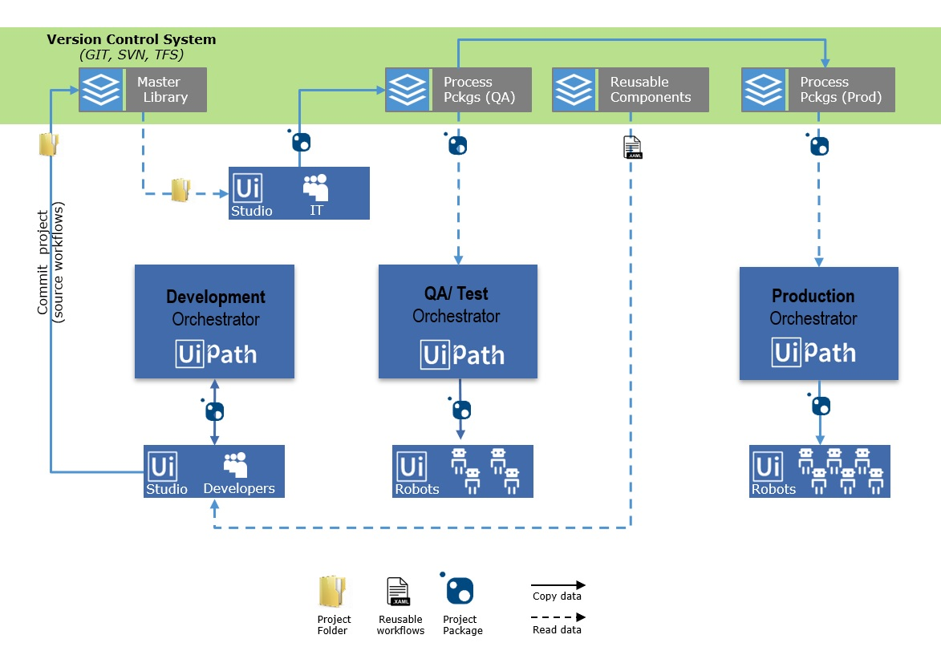
Automation Lifecycle
Process Understanding
Documenting the Process
Development and Code Review
Test
Release
Monitoring

Slide 40
Managing Variables
Variables are used to store multiple types of data
Variables need to be created with different names, even if used in different Scopes
The variable's name is its unique ID and it defines the way it’s being displayed and used
The data stored within a variable is called a value, and it can be of multiple types
In Studio, all strings have to be placed between quotation marks
Variables cannot be created if the Designer panel does not contain at least one activity

Slide 41
Creating Variables
From the Body of an Activity
From the Activities panel, drag an activity to the Designer panel. Right-click a field and select Create Variable from the context menu, or press Ctrl+K. The Set Var field is displayed.
Fill in the name and press Enter. The variable is created and visible in the field. Check its scope and type in the Variables panel.
Variables created in this way automatically receive the type according to the activity
The scope of variables created in this way is the smallest container it is part of
The type is automatically generated depending on the selected property.

Slide 42
Creating Variables
From the Properties Panel
In the Properties panel of any activity, right-click a field that can be edited, and select Create Variable from the context menu, or press Ctrl+K. The Set Var field is displayed.
Fill in the name and press Enter. The variable is created and visible in the field. Check its scope and type in the Variables panel.
The scope of variables created in this way is the smallest container it is part of
The type is automatically generated depending on the selected property.

Slide 43
Creating Variables
From the Variables Panel
In the Designer panel, click Variables. The Variables panel is displayed.
Click the Create Variable line, and fill in the name. A new variable is created.
The default type of variables created this way is String.

Slide 44
Removing Variables
In the Variables panel, right-click a variable and select the Delete option.
In the Variables panel, select a variable and press the Delete key.
You can also remove all the variables that are defined in the Variables panel, but not used in your currently opened project.
To do so, on the Design ribbon tab click Remove Unused Variables. This also removes variables that are unused but mentioned in annotations.
If you remove or upgrade a package that may lead to a variable or argument being undefined, an Unknown Type is added in its place so that the file can be opened and edited in Studio.

Slide 45
Types of Variables
Text Variables
A text or string variable is a type of variable that can store only strings.
These types of variables can be used to store any information such as employee names, usernames or any other string.
All strings in UiPath have to be placed in between quotes.
ACTIVITY 1:
Create a project that asks for the user’s name, stores it and displays only the first letter of given name in the Output panel

Slide 46
Types of Variables
True or False Variables
The true or false variable, also known as Boolean, is a type of variable that only has two possible values, true or false.
These variables enable you to make decisions, and thus have a better control over your flow.
ACTIVITY 2 :
Create an automation that asks the user for his name and gender, and displays the results in another window.

Slide 47
Types of Variables
Number Variables
Number variables are also known as integer or Int32
Used to store numeric information
They can be used to perform equations or comparisons, pass important data and many others.
ACTIVITY 3 :
Create an automation that asks the user for the year in which he or she was born and displays the age in a window.

Slide 48
Types of Variables
Array Variables
The array variable is a type of variable which enables you to store multiple values of the same type.
UiPath Studio supports as many types of arrays as it does types of variables.
This means that you can create an array of numbers, one of strings, one of Boolean values and so on.
ACTIVITY 4 :
Create an automation that asks the user for his first and last name and age, stores the information in an array and then writes it in a .txt file.

Slide 49
Types of Variables
Date and Time Variables
The date and time variable is a type of variable that enables you to store information about any date and time.
This type of variable can be found in the Browse and Select a .Net Type window, under the System namespace System.DateTime.
For example, they can be used to append dates to invoices or any other documents you may be working with and are time-sensitive.
ACTIVITY 5 :
Build an automation that gets the current date and time, subtracts a specific amount of time and writes the result to a Microsoft Excel spreadsheet.

Slide 50
Types of Variables
Data Table Variables
DataTable variables represent a type of variable that can store big pieces of information, and act as a database or a simple spreadsheet with rows and columns.
They can be found in the Browse and Select a .Net Type window, under the System.Data namespace (System.Data.DataTable).
These variables can be useful to migrate specific data from a database to another, extract information from a website and store it locally in a spreadsheet and many others.
ACTIVITY 6 :
Create an automation that reads only two out of multiple columns from an Excel spreadsheet, and then transfers them to another spreadsheet that already contains other information.
The initial file is a database of people, transactions, dates, and products. In this example, we are going to extract their names and order dates and append them to an Excel spreadsheet that already contains similar information.

Slide 51
UiPath Proprietary Variables
GenericValue Variables
The GenericValue variable is a type of variable that can store any kind of data, including text, numbers, dates, and arrays, and is particular to UiPath Studio.
GenericValue variables are automatically converted to other types, in order to perform certain actions. However, it is important to use these types of variables carefully, as their conversion may not always be the correct one for your project.
UiPath Studio has an automatic conversion mechanism of GenericValue variables, which you can guide towards the desired outcome by carefully defining their expressions.
Take into account that the first element in your expression is used as a guideline for what operation Studio performs.
For example, when you try to add two GenericValue variables, if the first one in the expression is defined as a String, the result is the concatenation of the two. If it is defined as an Integer, the result is their sum.

Slide 52
UiPath Proprietary Variables
QueueItem Variables
QueueItem variable stores an item which has been extracted from a container of items, a queue.
This extraction is generally made with the purpose of further using the queue items in various scenarios.
Let’s say you represent a banking institution and you have a deposits’ report of 50 clients. You want to process the data of each client who had previously deposited an On-Us Check smaller than $5000, using a third-party financial application.
In this regard, you can make a workflow in which the QueueItem variable stores, by turn, the information of each client. Each entry read by the QueueItem variable is stored in a queue item and added to the designated queue in Orchestrator.
The result of this whole process is a queue which contains the clients' information, each in the corresponding queue item.

Slide 53
Day 4 - Topics Covered
Arguments
Creating Arguments
Removing Arguments
Arguments Directions
Demo 1
Selectors
Full vs Partial Selectors
Dynamic Selectors
Selectors with wildcards
Demo 2
Data Scraping
Demo 3
Activities

Slide 54
Arguments
Arguments are used to pass data from a project to another
They resemble variables, as they store data dynamically and pass it on
Variables pass data between activities, while arguments pass data between automations
They enable you to reuse certain projects time and again.
Arguments have specific directions (In, Out, In/Out, Property) that tell the application where the information stored in them is supposed to go.
Arguments are exposed in Orchestrator
Argument names should be in upper CamelCase with a prefix stating the argument direction, such as in_DefaultTimeout, in_FileName, out_TextResult, io_RetryNumber.

Slide 55
Creating Arguments
From the Body of an Activity
From the Activities panel, drag an activity to the Designer panel. Right-click a field and select Create In Argument or Create Out Argument from the context menu. Alternatively, press Ctrl+M or Ctrl+Shift+M. The Set Arg field is displayed.
Arguments created in this way automatically receive the type according to the activity.
From the Properties Panel
In the Properties panel of any activity, right-click a field that can be edited, and select Create In Argument or Create Out Argument from the context menu. Alternatively, press Ctrl+M or Ctrl+Shift+M. The Set Arg field is displayed.
The argument type is automatically generated depending on the selected property.
From the Arguments Panel
In the Designer panel, click Arguments. The Arguments panel is displayed.
By default, all arguments are of String type and have an In direction.

Slide 56
Removing Arguments
To remove an argument:
In the Arguments panel, select an argument and press Delete.
In the Arguments panel, right-click an argument and select the Delete option.

Slide 57
Arguments - Directions
Select a direction for your argument. The following options are available:
In – the argument can only be used within the given project.
Out – the argument can be used to pass data outside of a given project.
In/Out – the arguments can be used both within and outside of a given project.
Property – not currently used.
Activity :
Part 1: Create N number of dummy files with different names in a folder. Fetch the count of files available in that folder and pass that as a argument to the next part.
Part 2: Create a workflow/sequence that accepts the argument being passed from part 1, navigate to the same location, fetch the count of all files and check if both counts are same.

Slide 58
Selectors
XML Fragment
Stores the attributes of a graphical user interface element and its parents
A selector has the following structure: <node_1/><node_2/>...<node_N/>
Last node represents the actual GUI element
Previous nodes represent the parents of that element
<node_1> is usually referred to as a root node, and represents the top window of the app
Selectors are stored in the Properties panel of activities, under Input > Target > Selector. All activities related to graphical elements have this property.
NOTE:
Every attribute has an assigned value. It is important to pick attributes with a constant value. If the value of an attribute changes each time the app is started, then the selector will not be able to correctly identify the element.

Slide 59
Full versus Partial Selectors
Full selectors:
Contain all the elements needed to identify a UI element, including the top-level window
Generated by the Basic recorder
Recommended when switching between multiple windows
Partial selectors:
Generated by the Desktop recorder
Do not contain information about the top-level window
Activities containing partial selectors are enclosed in a container (Attach Browser or Attach Window) that contains a full selector of the top-level window
Recommended when performing multiple actions in the same window

Slide 60
Selectors with Wildcards
Wildcards are symbols that enable you to replace zero or multiple characters in a string.
These can be quite useful when dealing with dynamically-changing attributes in a selector.
Asterisk (*) – replaces zero or more characters
Question mark (?) – replaces a single character

Slide 61
Dynamic Selectors
A dynamic selector uses a variable or an argument as a property for the attribute of your target tag.
This allows the selector to easily identify a target element based on the value of the variable or argument, and not an exact string, which might change, depending on interactions inside your automation project.
As such, the variable or argument can be changed to interact with a different element, without changing the selector itself.
A dynamic selector has the following form, with the specifications:
tag - the target tag, such as <ctrl/>
attribute - the target attribute, such as name='menuItem'
{{Value}} - the name of the variable or argument which holds the property of the element you want to interact with
Dynamic Selector Format
<tag attribute=`{{Value}}` />

Slide 62
Data Scraping
Data scraping enables you to extract structured data from your browser, application or document to a database, .csv file or even Excel spreadsheet.
The main steps of the data scraping wizard are:
Select the first and last fields in the web page, document or application that you want to extract data from, so that Studio can deduce the pattern of the information.
Customize column headers and choose whether or not to extract URLs.
Preview the data, edit the number of maximum results to be extracted and change the order of the columns.
Optionally click Extract Correlated Data. This enables you to go through the Extract Wizard again, to extract additional info and add it as a new column in the same table.
Indicate the Next button in the web page, application or document (if the information you want to extract spans multiple pages).
After you are finished with the wizard, a sequence is generated in Studio.
All the scraped information is stored in a DataTable variable, that you can later use to populate a database, a .csv file or an Excel spreadsheet.

Slide 63
Activity 1 :
Fetch all data results for any particular google search and store it in an excel
Activity 2 :
Read the book description, cost and publishing date from amazon results of book search, store in excel sheet

Slide 64
Mouse and Keyboard Activities
Double Click, Click, Hover are activities that simulate the clicking or hovering of UI elements. These activities are very useful in situations when human behavior must be mimicked.
Type Into sends keystrokes to a UI element. Special keys are supported and can be selected from the drop-down list. This is a basic text input activity that is widely used in automations and is also generated by the automatic recording wizards.
Type Secure Text sends a secure string to a UI element.
Send Hotkey sends keyboard shortcuts to a UI element. This activity is useful for accessing shortcuts in applications and can help you simplify your automation project.
Set Focus sets keyboard focus to a specified UI element. The ability to bring a certain window to the foreground is essential when performing image and text automation.
Demo 1 : To exemplify the automation of a process by using activities that simulate mouse and keyboard input, we created an automation that displays the IP address, subnet mask, and default gateway for all adapters from the Command Prompt, by using the ipconfig command and actions similar to human ones

Slide 65
Text Activities
Text recognition activities are useful in extracting text from UI elements on the screen, as well as extracting coordinates for UI elements relative to text on the screen.
Double Click Text, Click Text and Hover Text are activities used to click the text inside a UI element or hover over it. After the user interface object and text are specified, the activity searches the UI for the text and clicks it or hovers over it.
Find Text Position searches for a given string in a specified target, and returns a UIElement variable which has the clipping region set to the screen position of that string. This activity can be useful in locating UI elements relative to text on the screen when there is no other way of locating them, and using them further in your automation.
Get Full Text extracts a string and its information from an indicated UI element using the FullText screen scraping method.
Get Visible Text extracts a string and its information from an indicated UI element using the Native screen scraping method.
Extract Structured Data extracts data from an indicated table.

Slide 66
Studio Logs
The Studio Traces are diagnostic log messages generated by Studio, containing information related to its behavior.
The logging level settings and log file path can be modified by editing the <Installation Folder>\UiPath.Studio.exe.config file. If this file does not exist, it is automatically created when an event occurs. The section can be found under the <nlog> tag.
UiPath Studio Traces Logging Level
Default selected logging level for Studio is Information
To only log Error and Warning levels, specify them in between the <rules> tag
Targets of the UiPath Studio Traces
The default log file path for Studio is %localappdata%\UiPath\Logs\<shortdate>_Studio.log

Slide 67
Setup Logs
When running the Windows installer (UiPathStudio.msi), all errors are logged in the Event Viewer.
For more detailed logs, you can execute the installer from the command line with the following parameters:
msiexec.exe /i "path_of_the_installer" /lv* "path_of_the_log_file"
For example:
msiexec.exe /i "%UserProfile%\Downloads\UiPathStudio.msi" /lv* "%UserProfile%\Desktop\Log.txt"
Executing this command line generates a file called Log.txt to the specified folder, which contains the installation log data.
If you are running the user mode installer (.exe), setup logs are automatically generated and can be found in %localappdata%\SquirrelTemp\SquirrelSetup.log.

Slide 68
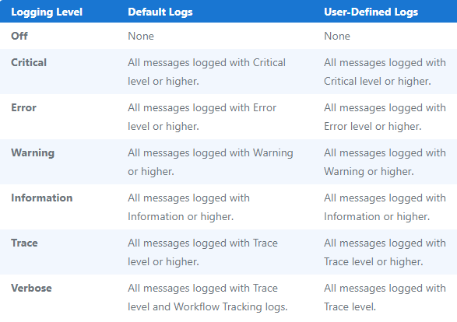
Logging Levels in UiPath
The Verbose level logs a message for both the activity start and end, plus the values of the variables and arguments that are used.
By default, the Verbose level includes:
Execution Started log entry - generated every time a process is started.
Execution Ended log entry - generated every time a process is finalized.
Transaction Started log entry - generated every time a transaction item is obtained by the robot from Orchestrator.
Transaction Ended log entry - generated every time the robot sets the transaction status to either Success or Failed.
Activity Information log entry - generated every time an activity is started, faulted or finished inside a workflow.

